Slide 1
VEDITOR A Voice-based Text Editor

Slide 2
Under the Guidance of
V. PAVANI (M.Tech)
Assistant Professor in Computer Science and Engineering,
Rajiv Gandhi University of Knowledge Technologies,
IIIT- Nuzvid, Krishna District, Andhra Pradesh
521202.

Slide 3
PRESENTED BY
G. SRILAKSHMI (N140218)
G. SREEKEERTHI (N140854)
K. AJAYREDDY (N141011)
S. AVINASH (N140891)

Slide 4
INDEX
Abstract
Existing System
Proposed System
Software & Hardware Requirements
Working Model
References

Slide 5
Abstract
“The world without word documents is unimaginable. Although it produces words correctly without any spelling mistakes, it lacks auto capitalization and punctuation marks With the technological revolutions impacting the billions of lives, it’s our responsibility to constantly update and upgrade our way of working. Speech-to-Text and Automatic Speech Recognition (ASR) systems have been evolved to whet the appetite of global technology leaders. We can type in the editor manually or dictate to a word-processing program to generally produce a word chain as output. We use python programs to punctuate sentences automatically. As a result, the sentences will become more comprehensible. This reduces the time and increases the efficiency of a Person, an Employee (or) a Techie”

Slide 6
Existing System
Google Cloud Speech-to-Text API
Chrome Speech Recognition
Text Editors (Dictate text only)
Lack of Automatic Punctuation

Slide 7
Proposed System
Speech to Text with Automatic Punctuation
Restoration of punctuation symbols and capitalization in output
Build a sequence to sequence model
Training with sample input and output sentences.

Slide 8
Software Requirements
Python Libraries : tensorflow, keras, re txt2txt, deepcorrection
API : google-cloud-speech
Framework : FLASK
Software's : Python 3.7
Scripting Languages : HTML, CSS, JS
Browsers : Google Chrome
Resources : Conversational data from tatoeba.org

Slide 9
Hardware Requirements
RAM : 8 GB
ROM : 1 TB

Slide 10
Working Model
Conversational data
Preprocessing
Seq-To-Seq Model
Deep Correction
Traning & Testing
Voice Based Web Application
Integration
Punctuated Output
Data Collection
Model Building
Output

Slide 11
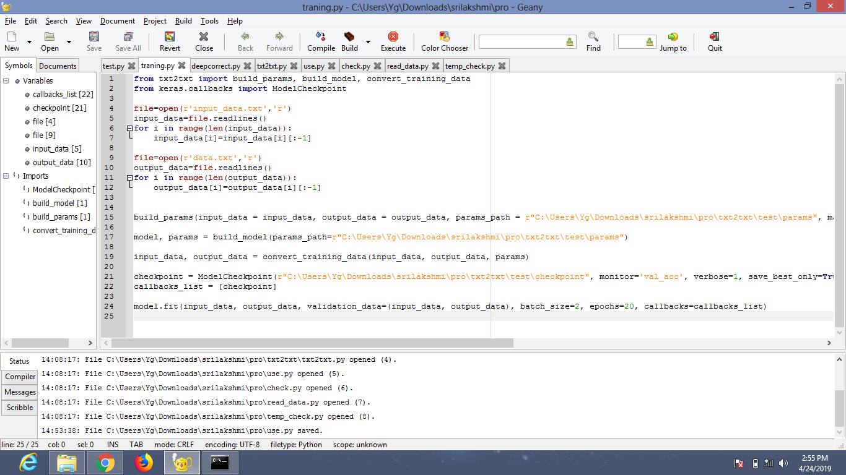
Data Preprocessing
Removing new lines(\n) in sample input and output data.

Slide 12
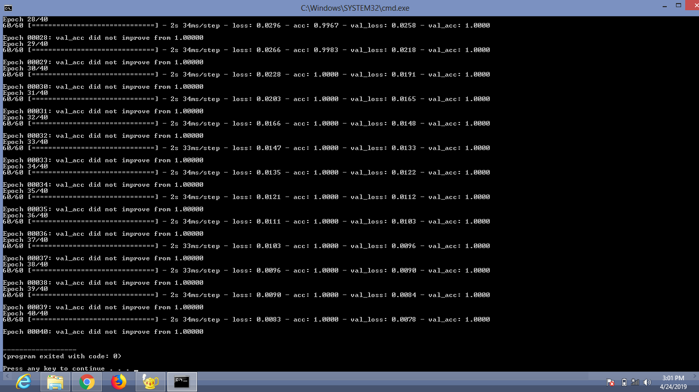
Sequence-To-Sequence Model
Training the Sequence to Sequence model( Long Short Term Memory) with sample input and output Sentences.
It maps the fixes length input with a fixed length output and their lengths may differ

Slide 13
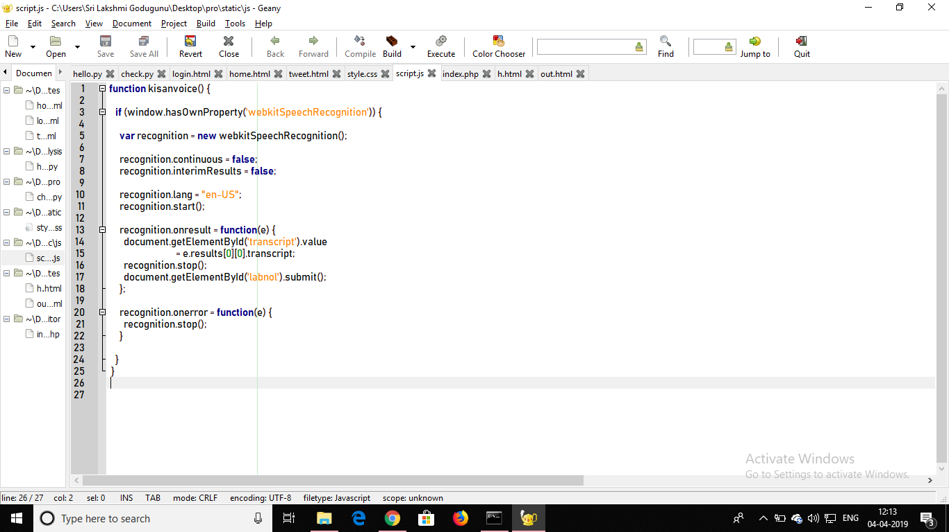
Voice based Web Application
Web-Application with Voice-recognition feature

Slide 14
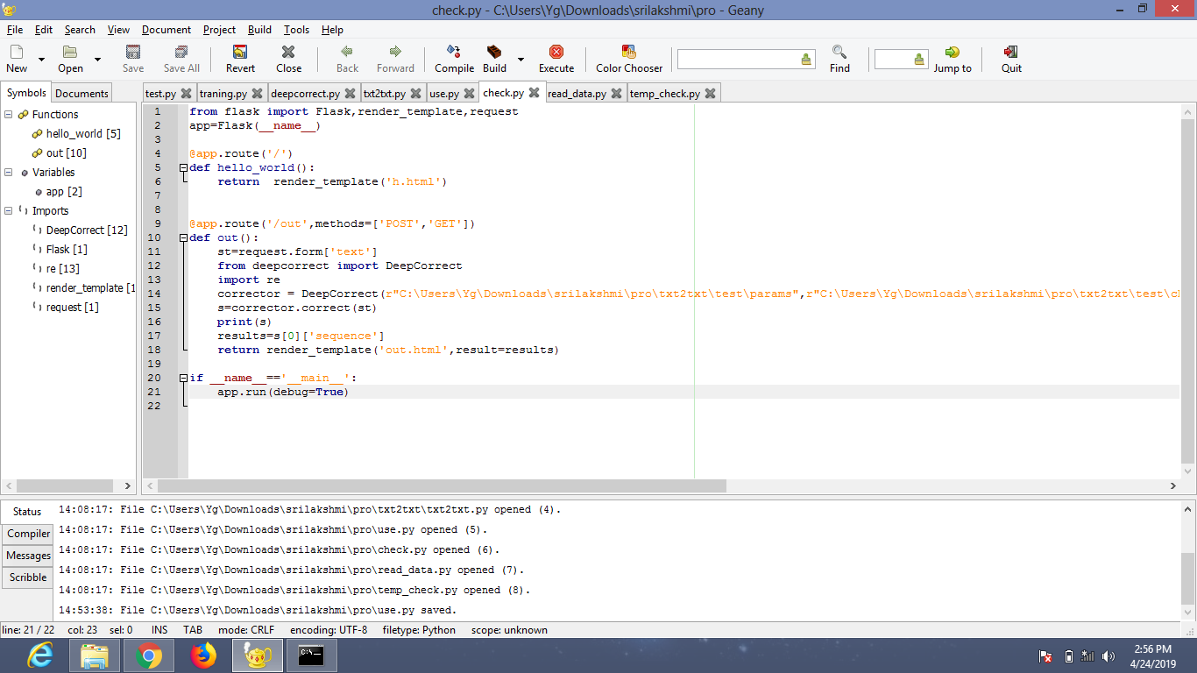
Integration using FLASK

Slide 15
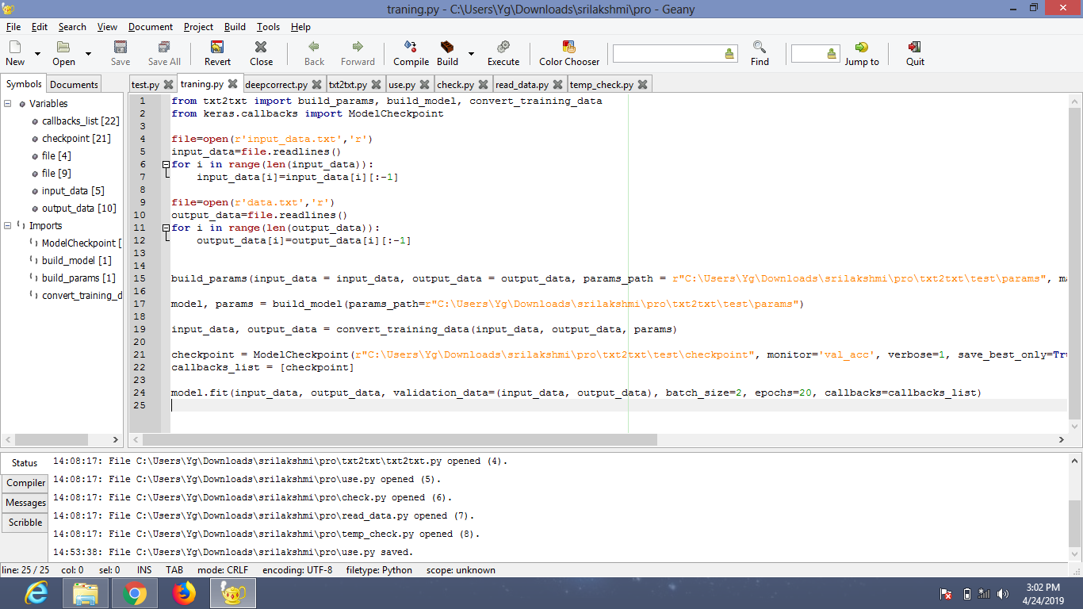

Slide 16
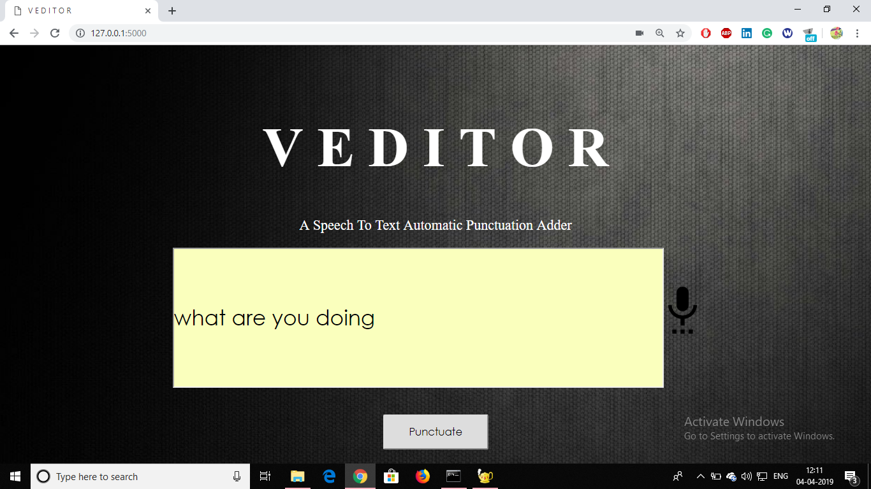
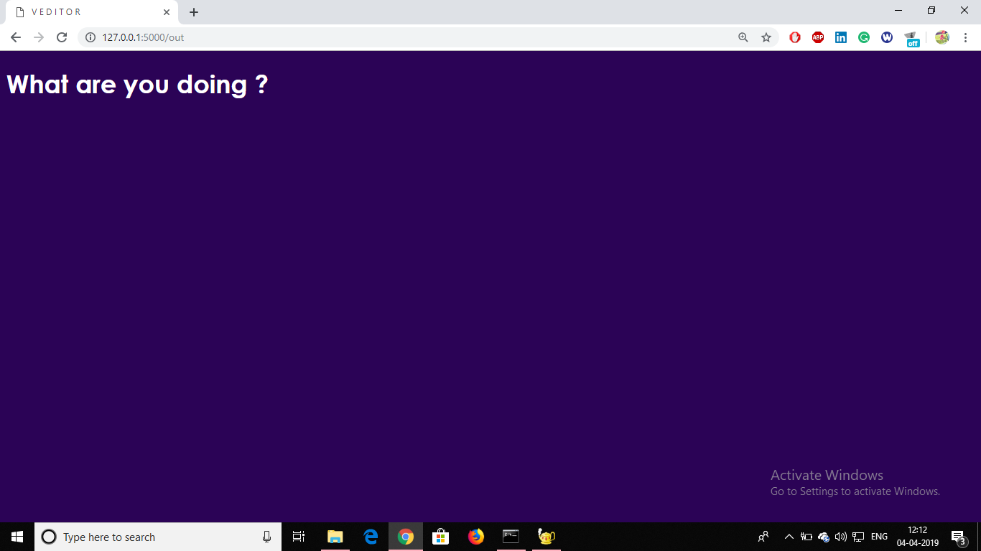
Example
Input
Output

Slide 17
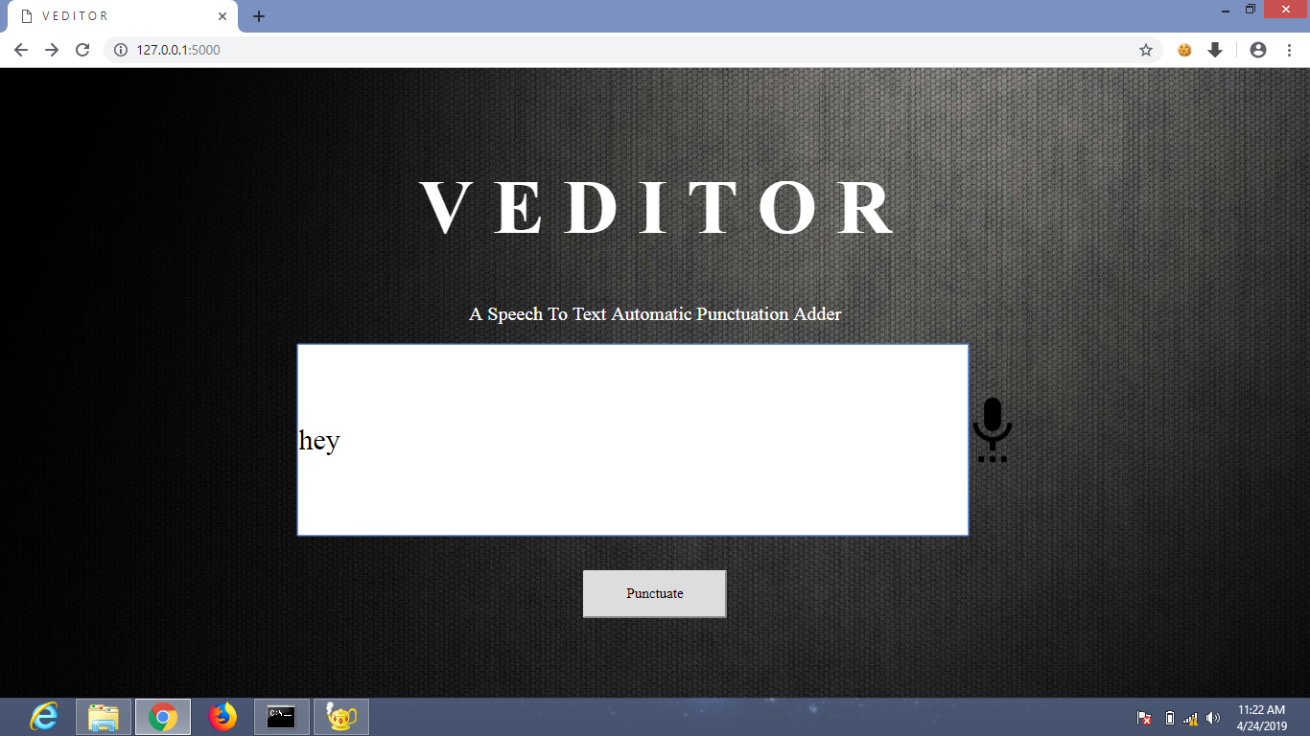
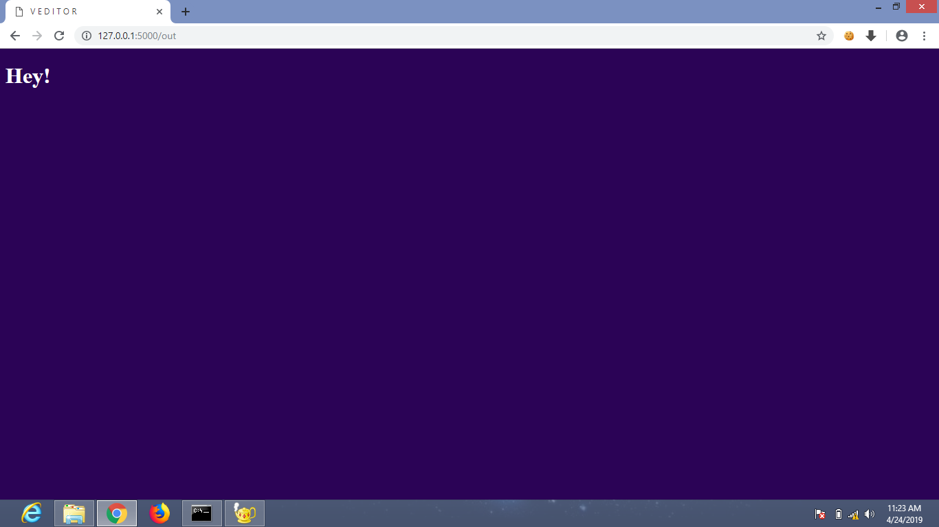
Example
Input
Output

Slide 18
References
https://medium.com/@praneethbedpudi/deepcorrection2-automatic-punctuation-restoration
Restoring punctuation and capitalization in transcribed speech
Conversational data from tatoeba.org

Slide 19


